Slide 1

Recommendations in Spotify
Muzamel Hashimi
Martha Kabakaki
Ian Van de Vondel
Thibo Vanderkam
Notes:
Spotify’s Mathematical System For Determining Your Music Taste - YouTube

Slide 2




Not just 1 algorithm
Collaborative Filtering
Natural Language Processing System
Sonic Profiles

Slide 3

Collaborative Filtering
Con: Bias towards popular songs
 | Elke | Collin
Unhealthy | 1 | 1
Chemical | 1 | 0
(It Goes Like) Nanana | 1 | 0
Baby Shark Dance | 1 | 1
0800 Heaven | 1 | 2

Slide 4

Natural Language Processing System
Interpret
Speech
Text
React
Notes:
Explain the meaning of Natural Language Processing System. The application of spotify is on the next slide.
The NLPS can interpret from for example speech and text and can then react by (in spotify's case) by recommending a song.

Slide 5
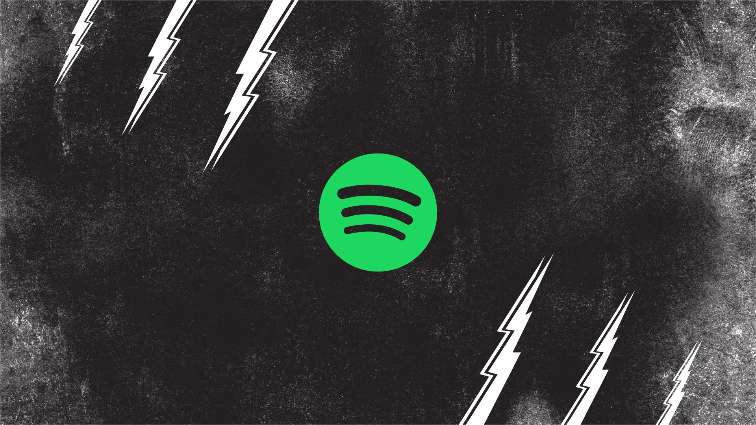
How is Spotify using this
NLP and user feedback
User Profiles
Content Tagging and Analysis
Personalization
Improving Recommendations
Notes:
Natural Language Processing (NLP) and the Spotify Recommendation AI are two different technologies, but they can work together to improve the recommendation experience for users. Here's how they are related:
NLP and user feedback: Spotify can use NLP systems to understand and analyze user feedback. This can be done by analyzing user reviews, comments on social media or even direct feedback from users on the platform. Through NLP, they can understand what people like and dislike about their recommendations and service.
User profiling: Spotify often uses NLP technology to better understand user profiles. They can extract information from textual descriptions or playlist names to learn more about a user's music taste.
Content Tagging and Analysis: Spotify uses NLP to analyze and tag songs, albums and playlists based on content and text analysis. This can help identify the mood, genre and other characteristics of music, allowing them to make more accurate recommendations.
Personalization: The Spotify Recommendation AI uses machine learning and algorithms to make personalized playlists and song recommendations. These recommendations are made based on information gathered through NLP and other data sources, such as listening history and preferences.

Slide 6

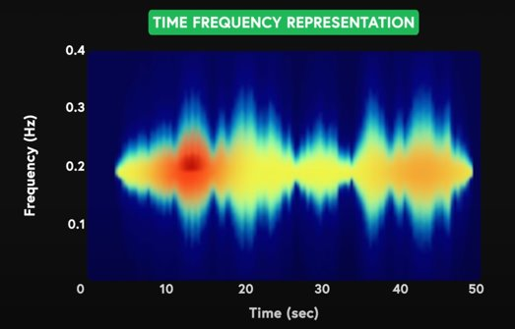

Sonic Profiles

Slide 7
Sonic Profiles
Neural network
Key
Loudness
Time Signature
Tempo
Timbre
Notes:
Natural Language Processing (NLP) and the Spotify Recommendation AI are two different technologies, but they can work together to improve the recommendation experience for users. Here's how they are related:
NLP and user feedback: Spotify can use NLP systems to understand and analyze user feedback. This can be done by analyzing user reviews, comments on social media or even direct feedback from users on the platform. Through NLP, they can understand what people like and dislike about their recommendations and service.
User profiling: Spotify often uses NLP technology to better understand user profiles. They can extract information from textual descriptions or playlist names to learn more about a user's music taste.
Content Tagging and Analysis: Spotify uses NLP to analyze and tag songs, albums and playlists based on content and text analysis. This can help identify the mood, genre and other characteristics of music, allowing them to make more accurate recommendations.
Personalization: The Spotify Recommendation AI uses machine learning and algorithms to make personalized playlists and song recommendations. These recommendations are made based on information gathered through NLP and other data sources, such as listening history and preferences.

Slide 8
Recommendations in Spotify
Muzamel Hashimi
Martha Kabakaki
Ian Van de Vondel
Thibo Vanderkam
Notes:
Spotify’s Mathematical System For Determining Your Music Taste - YouTube

